Slide 1
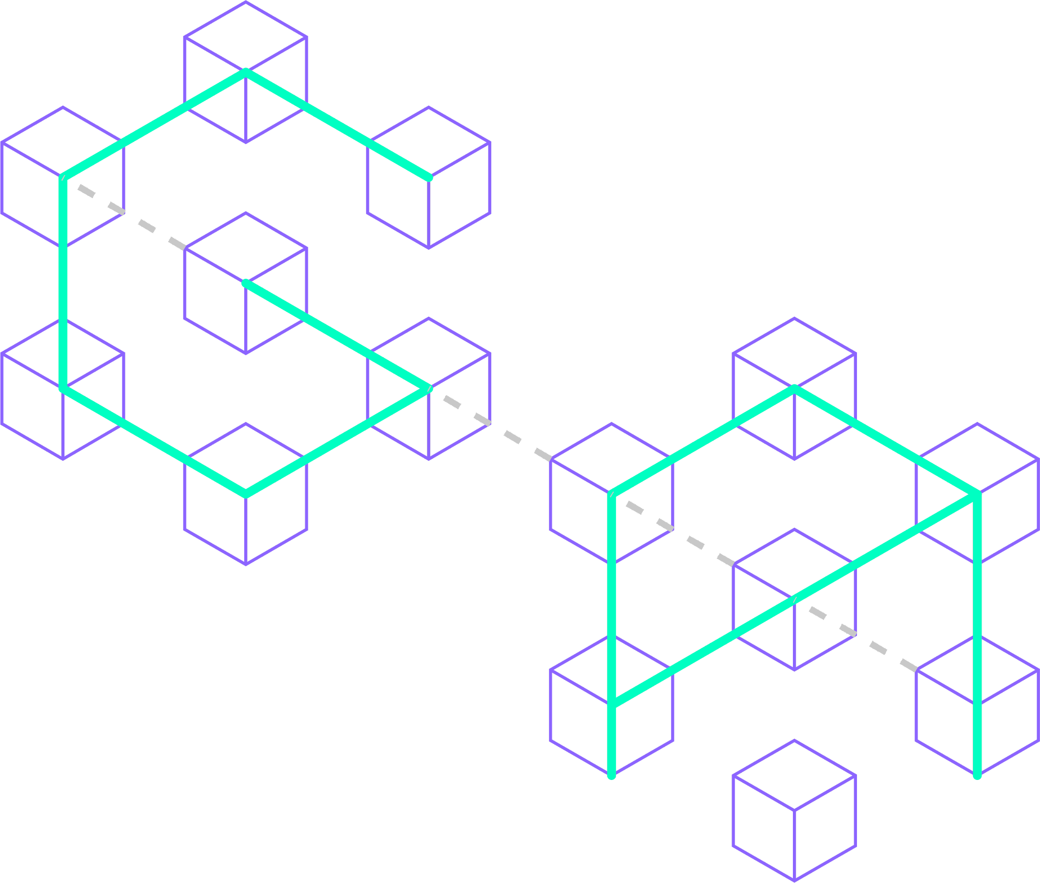



Diving into Metis:
The Unique Layer 2 Solution for True Decentralization

Slide 2
Heading 1
Heading 2
Source:
Date as of May 23, 2023
Note:
Twitter: @GryphsisAcademy

Slide 3
Radiant Team
Core Team | George·Tom·Aaron·Liam·Roger
Dev Ops | Marcel-Front End Developer Steve-Front End Developer Daniel-Smart Contract Engineer Roy-SmartContracts/BackEnd JD-Junior Developer
Director of Communications | Isaac Prada
DAO Admin | Hung Vu
Support Staff | Konstantin·Ed·HungVu·Dodge·Masterexit·0xStorm
Source: Gryphsis Academy
Date as of May 31, 2023
Twitter: @GryphsisAcademy

Slide 4
Radiant Team
Core Team | Dev Ops | Communications | Support | Business Development | DAO Admin
Aaron | Daniel | Isaac Prada | Dodge | Konstantin | Hung Vu
George | JD |  | Ed | 0xStorm
Liam | Marcel |  | Hung Vu
Roger | Roy |  | Konstantin
Tom | Steve |  | 0xStorm
Source: Gryphsis Academy
Date as of May 31, 2023

Slide 5
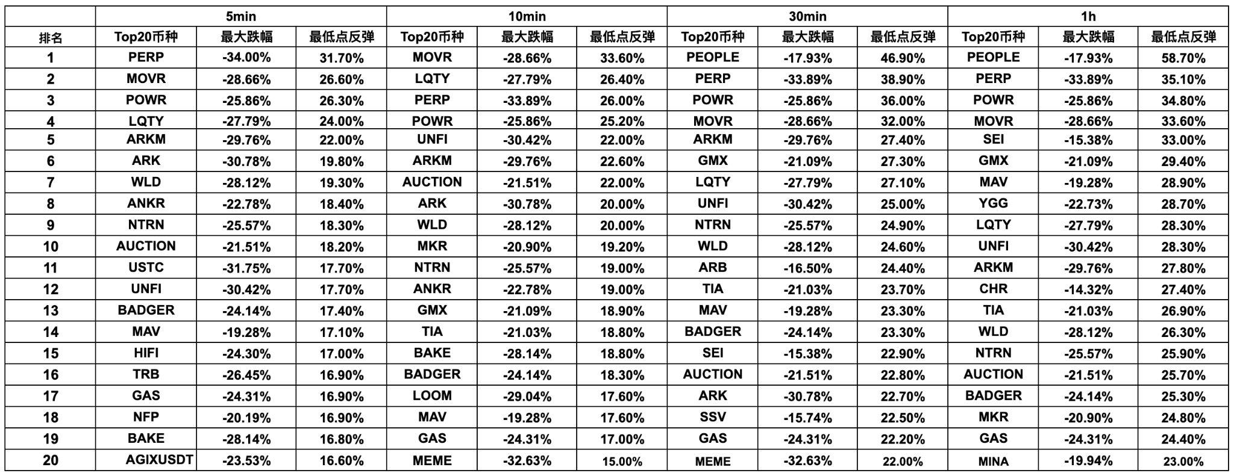
山寨插针反弹表现
Binance 交易所现货 USDT 交易对
Source: Binance
Date as of Jan 3, 2024
Twitter: @GryphsisAcademy

Slide 6
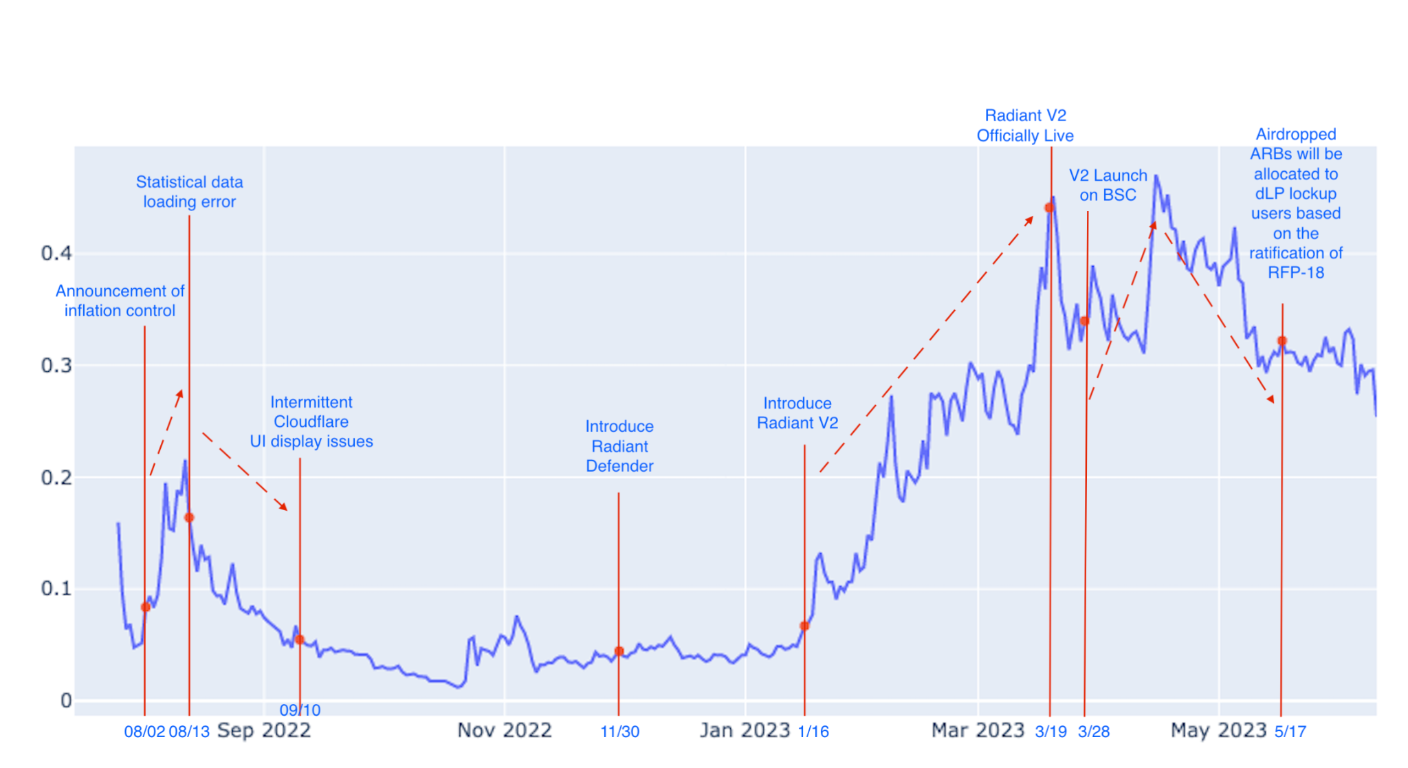
RDNT Price & Historical Events
Date as of May 31, 2023
Source: Coin Marketcap, Gryphsis Academy
Twitter: @GryphsisAcademy

Slide 7
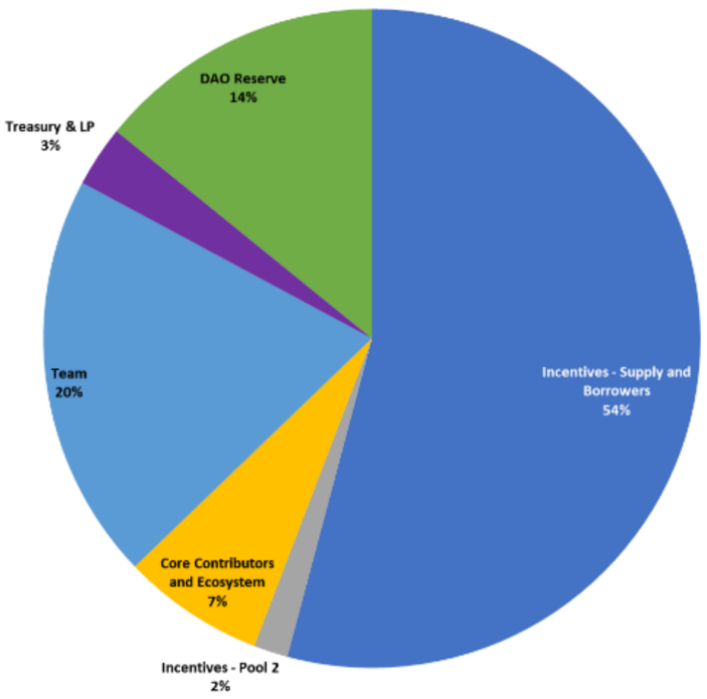
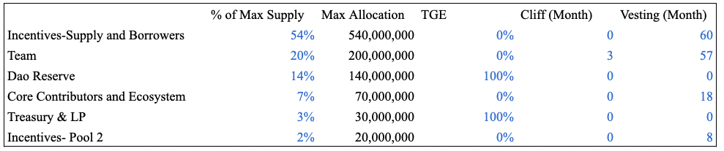
Token Allocation
Source: https://docs.radiant.capital/radiant/project-info/rdnt-tokenomics
Date as of May 31, 2023
Twitter: @GryphsisAcademy

Slide 8
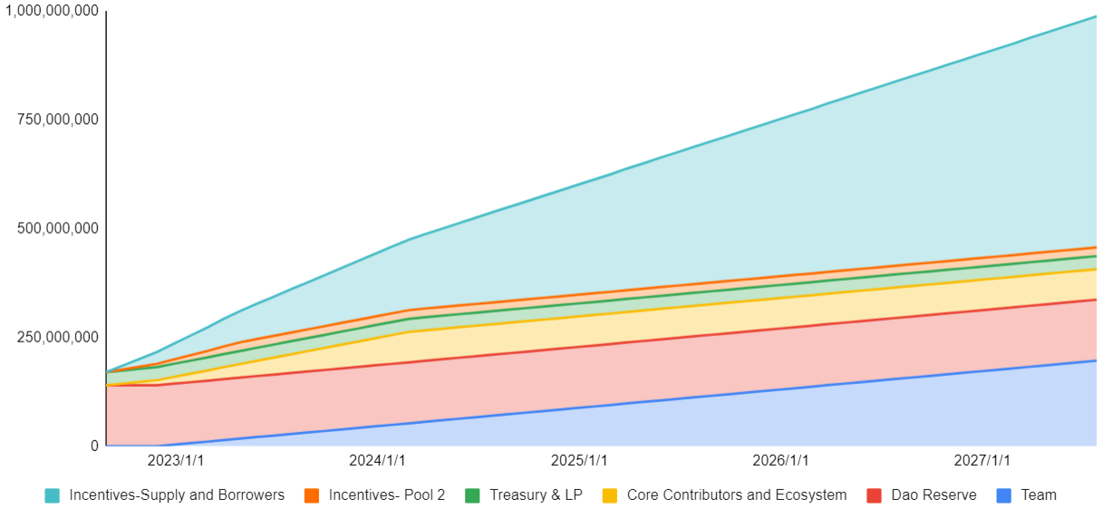
Release Schedule
Source: Gryphsis Academy
Date as of May 31, 2023
Twitter: @GryphsisAcademy

Slide 9
Radiant Lending Market Assets
 | Arbitrum | BSC
Stablecoins | DAI | BUSD
 | USDC | USDC
 | USDT | USDT
BTC/ETH | ETH | ETH
 | WBTC | BTCB
 | WSTETH
Alt L1/L2 | ARB | BNB
Source: Gryphsis Academy
Date as of May 31, 2023
Twitter: @GryphsisAcademy

Slide 10
Business Development Progress
Partners | Details
Stargate | Layer Zero / Stargate have cooperated with Radiant on many fronts since launch, including peer-reviewing Radiant’s smart contracts. Per Stargate’s snapshot proposal, the RDNT token will be supported as a bridgeable asset via their OFT bridge
Lido Finance | Radiant Capital will support wstETH as part of the v2 deployment, and Lido will participate in a dual incentives program.
Balancer | Radiant recently launched v2 in partnership with Balancer as part of the plans to expand RDNT liquidity. Within 24 hours, the RDNT-WETH pool became the largest Balancer pool on Arbitrum.
Chainlink | Radiant has relied on Chainlink oracles since inception for all collateral assets on Arbitrum and will continue expanding Chainlink oracle support in the Omnichain vision.
Arrakis & Gamma Strategies | Radiant is partnering with Arrakis and Gamma Strategies per on-chain governance vote in order to expand multi-chain protocol owned liquidity.
Source: Gryphsis Academy
Date as of May 31, 2023
Twitter: @GryphsisAcademy

Slide 11
Radiant Development Roadmap
Version | Roadmap
V1.0 | Fork of AAVE with Stargate expanding omnichain vision. Implementation and Real Yield. Solely on Arbitrum.
V2.0 | LaverZero OFT implementation.Can scale to every EVM chain. Emissions extended to 2027. Dozens of new assets are to be supported as collateral.
V3.0 | Forego STG for full LayerZero implementation. Continue expanding omnichain vision.
V4.0 | Become the “LayerZero'' for liquidity &yield. Help onboard the next 100 million users for crypto.
Source: Gryphsis Academy
Date as of May 31, 2023
Twitter: @GryphsisAcademy

Slide 12
Completed Milestones
Season | Milestones
2022 Q3 | Radiant Capital Fair Launches on Arbitrum
 | Radiant grows to top TVL project on Arbitrum
2022 Q4 | Unveil Radiant’s framework for DAO-based governance and the Radiant Foundation Proposal (RFP)
 | Dynamic Liquidity Providers Achieve $5M in Fees
2023 Q1 | Become the first Price/Fees Ratio Project in DeFi per TokenTerminal
 | Launch of Radiant v2
Source: Gryphsis Academy
Date as of May 31, 2023
Twitter: @GryphsisAcademy

Slide 13
Current Roadmap
Season | Milestones
Q2 2023 | 1. Dual-emissions and expanded Oracle support
 | 2. Collateral expansion
 | 3. Ethereum Mainnet Deployment
Q3 2023 | 1. Deployment on more chains
 | 2. Cross-Chain liquidations
 | 3. Abstracted repayments → repay on any chain
 | 4. Full LayerZero Messaging support
Q4 2023 | Radiant Synthetics
Source: Gryphsis Academy
Date as of May 31, 2023
Twitter: @GryphsisAcademy

Slide 14
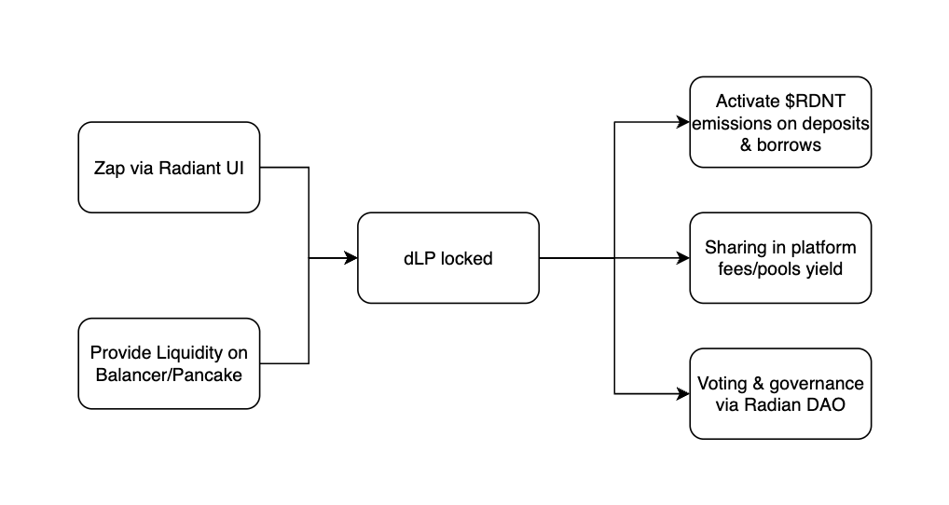
dLP Function Chart
Source: Gryphsis Academy
Date as of May 31, 2023
Twitter: @GryphsisAcademy

Slide 15
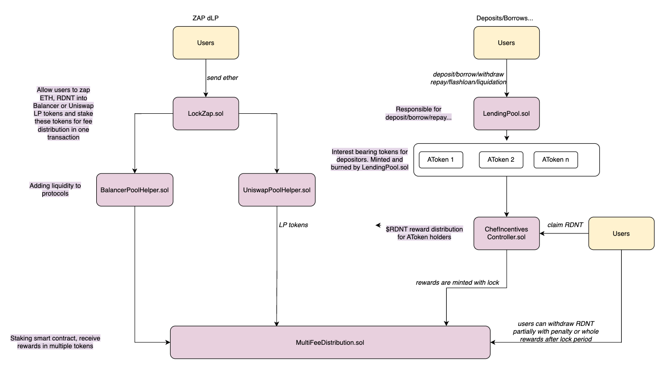
Business Logic Code Implementation
Source: Gryphsis Academy
Date as of May 31, 2023
Twitter: @GryphsisAcademy

Slide 16
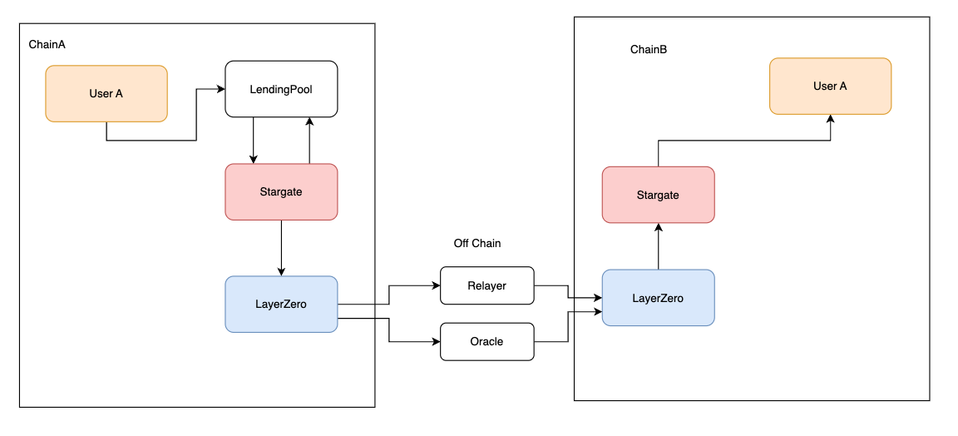
LayerZero/Stargate Integration Flow Chart
Source: Gryphsis Academy
Date as of May 31, 2023
Twitter: @GryphsisAcademy

Slide 17
Radiant TVL Ranking
 | Ranking
DeFi | 21
Lending (all chians) | 6
Lending (Arbitrum) | 1
Lending (BSC) | 3
Source: Defillama
Date as of May 31, 2023
Twitter: @GryphsisAcademy

Slide 18
Cross-chain Lending Competitive Space
 | TVL | Status
Radiant | 612.6M | Arbitrum, BSC
AAVE | 9B | Multiple Chains
Lend Hub | 9,291 | Heco
Goledo Finance | 6.4M | Conflux Network
Cedro Finance | Testnet
Prime | Testnet
Tashi | Developing | Evmos
Compound | 2.54B | Multiple Chains
Source: Tokenterminal
Date as of June 14, 2023
Twitter: @GryphsisAcademy
Notes:
radiant tvl - 612.6M
aave – 9 b
compound - 2.54 b
goledo = 6,405,443
lendhub 9,291
defillma 6/14

Slide 19
Token Allocation Version Differences
 | V1 | V2
Lenders and Borrowers | 50% | 70% (+ community)
Pool2 | 20%
Team | 20% | 20%
Advisors & Ecosystem | 7% | 7%
DEX and CEX Liquidity | 3% | 3%
RDNT DAO Reserve |  | No formal allocation
Source: Radiant Capital
Date as of May 31, 2023
Twitter: @GryphsisAcademy

Slide 20
Lending Competitive Space Key Metrics
 | Radiant | Aave | Venus | Compound
TVL | 577.51m | 8.07b | 1.1b | 2.53b
Active Loans (Annualized) | 365.3m | 2660m | 428.93m | 770m
Active Loans/TVL | 63% | 33% | 39% | 30%
MCap (Fully diluted) | 261.66 | 890.76 | 105.85 | 278
Mcap/TVL | 0.45 | 0.11 | 0.10 | 0.11
Revenue Annualized | 11.61 | 12.94 | 2.33 | 3.71
Users 30D (May) | 36.8k | 28.5k | 191.46 | 99.43
TVL | 577.51m | 8.07b | 1.1b | 2.53b
Trading Volume (May) | 740.7m | 1.2b | 93.9m | 141.5m
Source: Tokenterminal
Date as of June 14, 2023
Twitter: @GryphsisAcademy

Slide 21
Radiant v.s. AAVE
Utilization Rate Comparison
 | Radiant | AAVE(on arbitrum)
WBTC | 42.47% | 12.68%
WETH | 55.92% | 48.78%
DAI | 61.82% | 58.52%
USDC | 61.52% | 75.03%
USDT | 62.10% | 78.74%
Source: Dune, aavescan
Date as of May 31, 2023
Twitter: @GryphsisAcademy

Slide 22
Radiant Utilization Rate
 | Monthly Average | Assumption
StabeCoins | 72.48% | 73%
BTC/ETH | 52.7% | 50%
Alt L1/L2 | 57.18% | 50%
Source: Dune
Date as of May 31, 2023
Twitter: @GryphsisAcademy

Slide 23
DCF Analysis - TVL Growth Assumptions
BTC&ETH | Growth Rate 2024 | Growth Rate 2028 | BTC/Gold 2028 | ETH/Microsoft 2028
Low | 20% | 15% | 5% | 7%
Moderate | 30% | 20% | 7% | 9%
High | 40% | 25% | 9% | 13%
Stabe Coins | Growth Rate 2024 | Growth Rate 2028 | Stabecoins/Gold 2028
Low | 15% | 10% | 18%
Moderate | 20% | 15% | 18%
High | 30% | 20% | 20%
Alt L1/L2 | Growth Rate 2024 | Growth Rate 2028 | Alt L1&L2/ETH 2028
Low | 50% | 30% | 0.05%
Moderate | 80% | 40% | 0.11%
High | 120% | 50% | 0.21%
Source: Gryphsis Academy
Date as of May 31, 2023
Twitter: @GryphsisAcademy

Slide 24
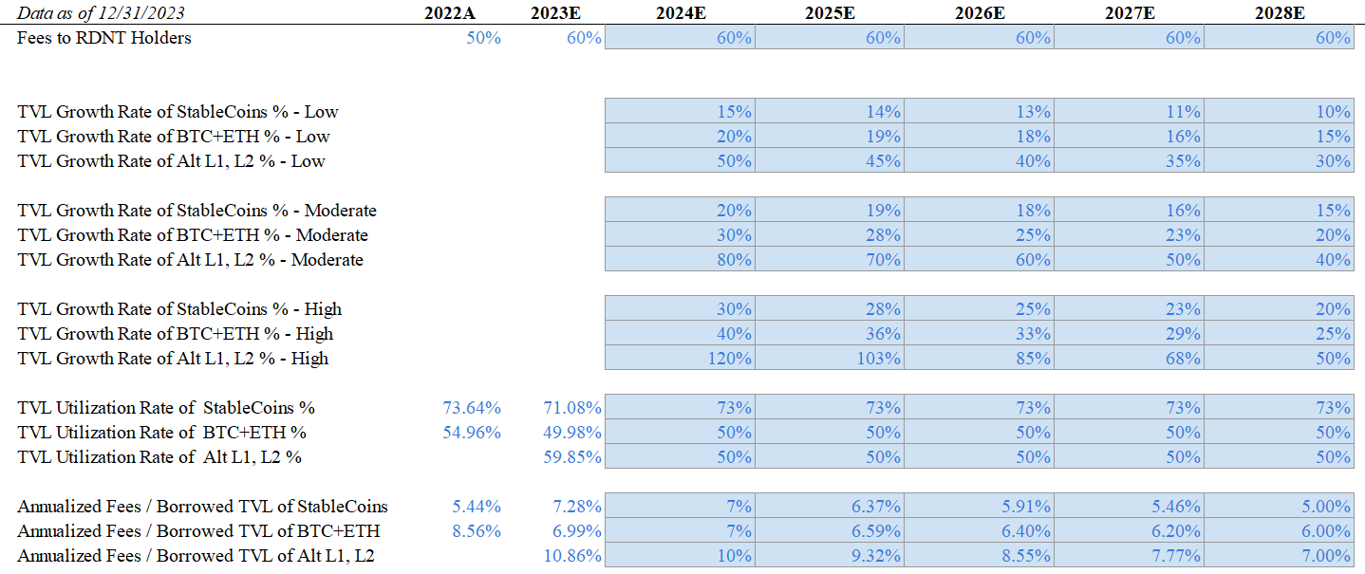
DCF Analysis - Assumptions
Source: Gryphsis Academy
Date as of Dec 31, 2023
Twitter: @GryphsisAcademy

Slide 25
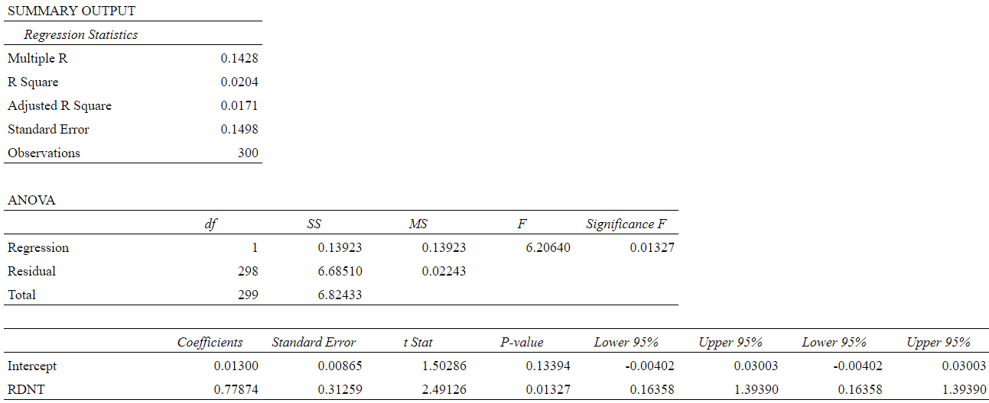
Regression Output
Source: Gryphsis Academy
Date as of May 20, 2023
Twitter: @GryphsisAcademy

Slide 26
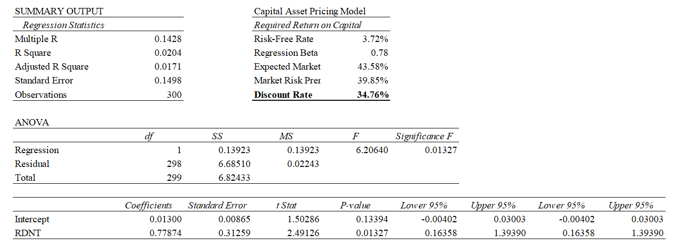
Regression Output
Discount Rate
Source: Gryphsis Academy
Date as of May 20, 2023
Twitter: @GryphsisAcademy

Slide 27
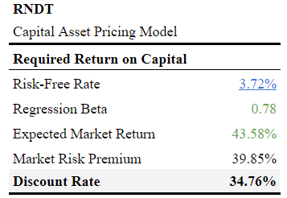
Rate of Return
Source: Gryphsis Academy
Date as of May 20, 2023
Twitter: @GryphsisAcademy

Slide 28
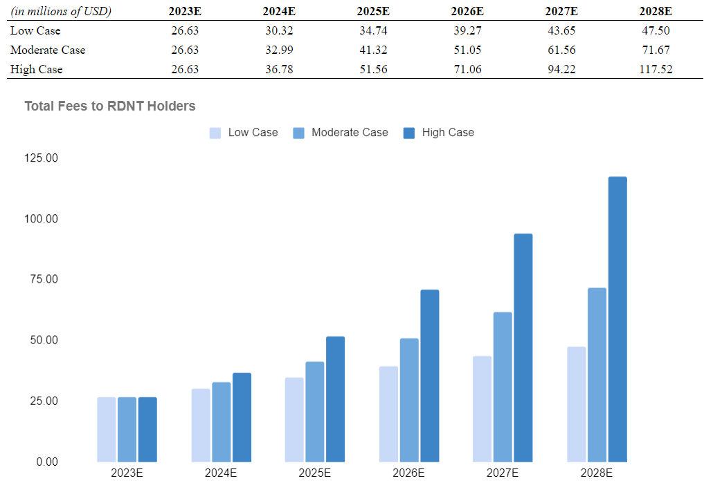
Radiant Total Fees Projection
Source: Gryphsis Academy
Date as of Dec 31, 2023
Twitter: @GryphsisAcademy

Slide 29
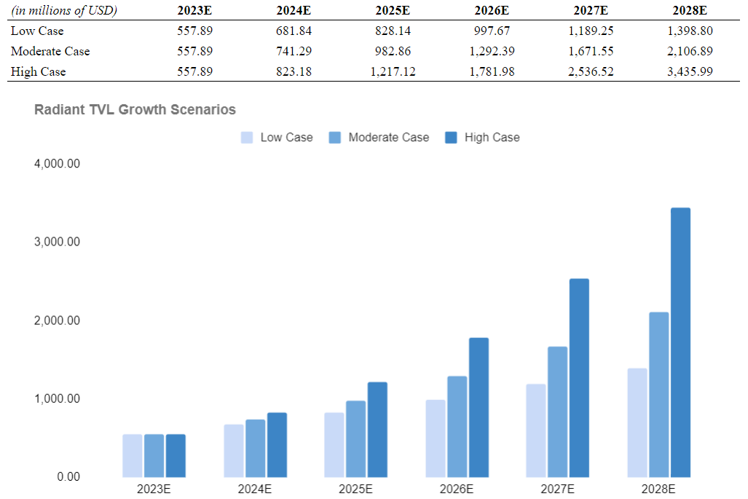
Radiant TVL Projection
Source: Gryphsis Academy
Date as of Dec 31, 2023
Twitter: @GryphsisAcademy

Slide 30
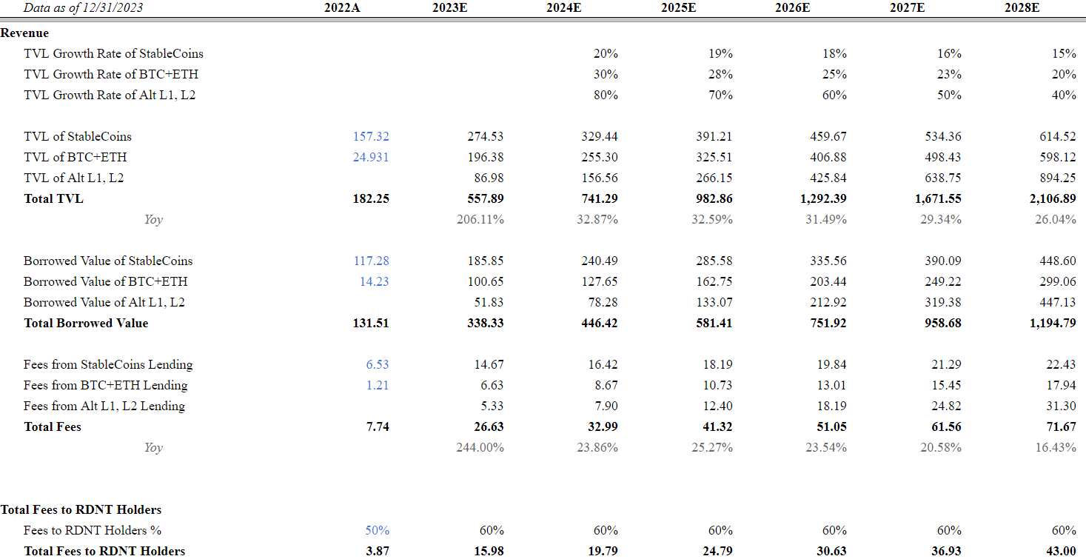
DCF Analysis - Moderate Case
Source: Gryphsis Academy
Date as of Dec 31, 2023
Twitter: @GryphsisAcademy

Slide 31
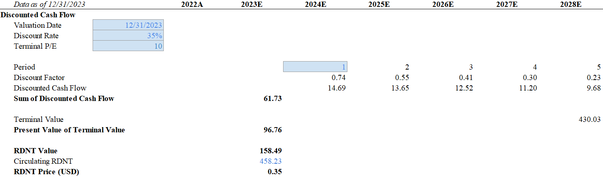
DCF Analysis - Moderate Case
Source: Gryphsis Academy
Date as of Dec 31, 2023
Twitter: @GryphsisAcademy

Slide 32
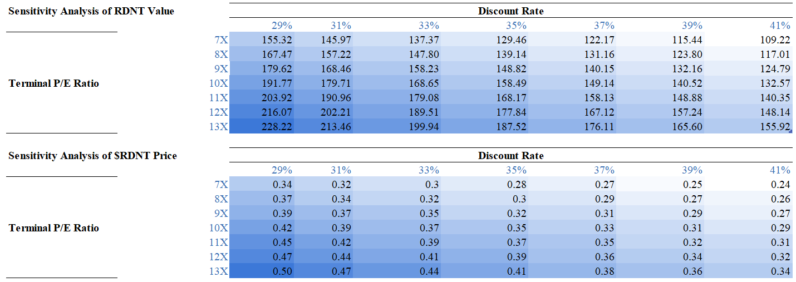
Sensitivity Analysis of RDNT Value & Price
Source: Gryphsis Academy
Date as of Dec 31, 2023
Twitter: @GryphsisAcademy

Slide 33
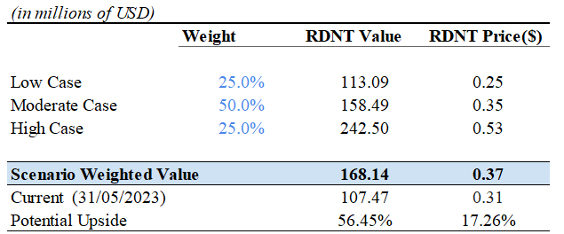
Probability-Weighted DCF Analysis
Source: Gryphsis Academy
Date as of Dec 31, 2023
Twitter: @GryphsisAcademy

Slide 34
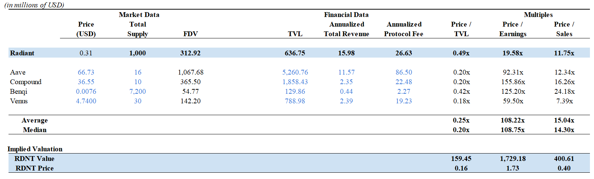
Comparable Analysis
Source: Gryphsis Academy
Date as of May 31, 2023
Twitter: @GryphsisAcademy

Slide 35
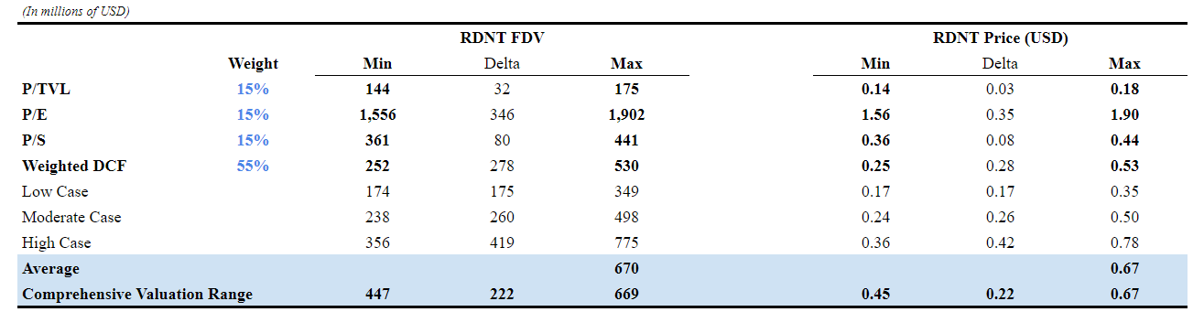
Comprehensive Analysis
Source: Gryphsis Academy
Date as of Dec 31, 2023
Twitter: @GryphsisAcademy

